Slide 1
9/18/24 Meeting

Slide 2
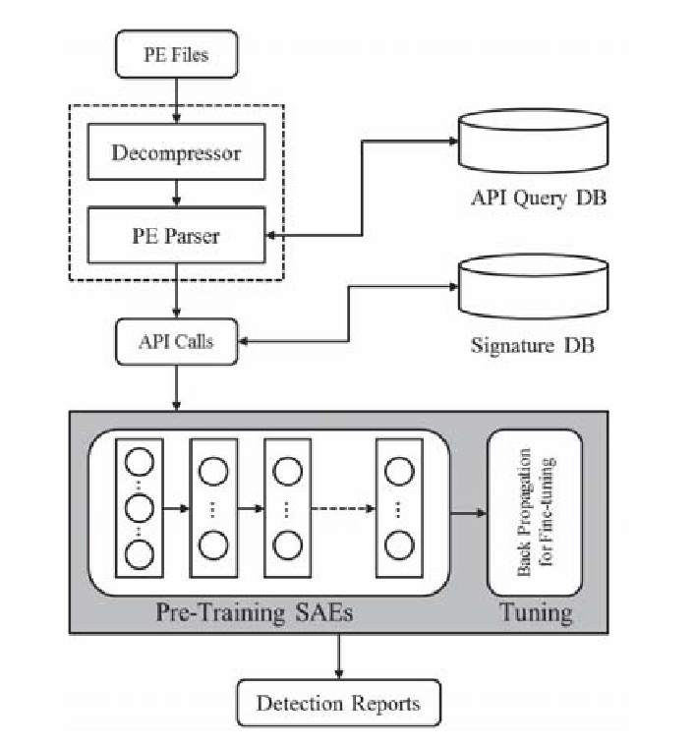
[31] “DL4MD” (Hardy et al)
PE Files parsed for API calls -> Stacked SAE model
Feature Vector of API calls
3x Stacked AutoEncoders
Binary Classification
Unsupervised Feature Learning through SAEs
Challenges/problems:
AutoEncoders reconstruct the input (?)
Cross-Validation; Acc.: ~96%
Source:
Code: N/A (some pseudocode in paper)
Data: Comodo Cloud Security
Secondary Reading: Faster Learning Algorithm for Deep Nets

Slide 3
[85] “Shallow End” (Le et al)
CNN-BiLSTM
Byte-Code samples scaled to uniform size
Wrapped to 2D grayscale images (1 byte per pixel)
Byte-wise image processing and classification
Challenges/problems:
Classifies malware type
Does not appear to be capable of “benign” classification (aka. detection)
5-fold cross-validation; Acc.: 98.20%
Source:
Code: N/A
Data: Microsoft Malware Classification Challenge

Slide 4
[78] “Structural Entropy” (Gilbert et al)
Convolutional Net based on program’s Shannon Entropy over time
Information Theory Entropy and Wave Transform equations
Mapped by multi-layer CNN-ReLU activations
Structural Entropy analysis is resilient to Evasion
Challenges/problems:
Classifies malware type (not detection-focused)
Potential for false-positives on complex benign programs
10-fold Cross-Validation; Acc.: 98.28%, F1: 96.36%
Source:
Code: https://github.com/danielgibert/mlw_classification_structural_entropy
Data: Microsoft Malware Classification Challenge

Slide 5
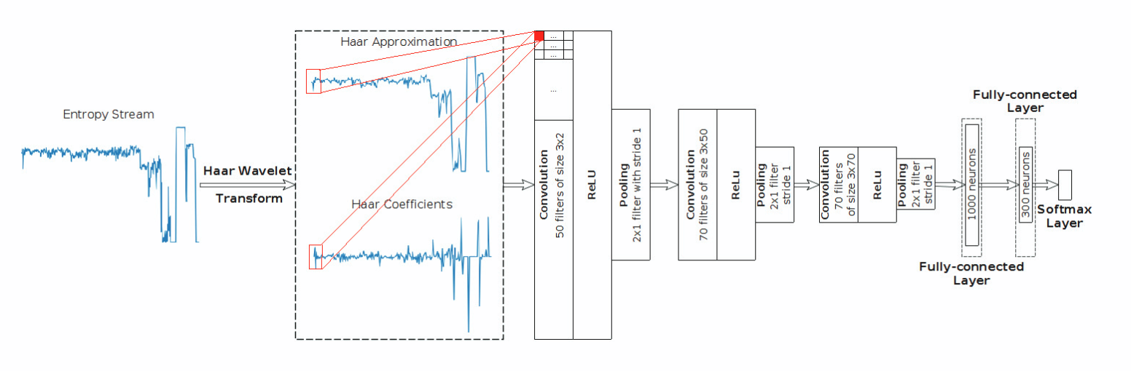

Slide 6
[79] IoT and Family Attribution (Dib et al)
CNN and LSTM concurrent modeling of features combined for output
Image-representation of bytecode
Bytecode reverse engineered to strings
Ensemble-Style Multi-Model Detection Scheme
Challenges/problems:
Authors suggest potential vulnerability to adversarial evasion
10-fold cross validation with dataset resampling; Acc.: 99.78%, F1: 99.57%
Source:
Code: N/A
Data:
VirusTotal and VirusShare
IoT honeypot

Slide 7
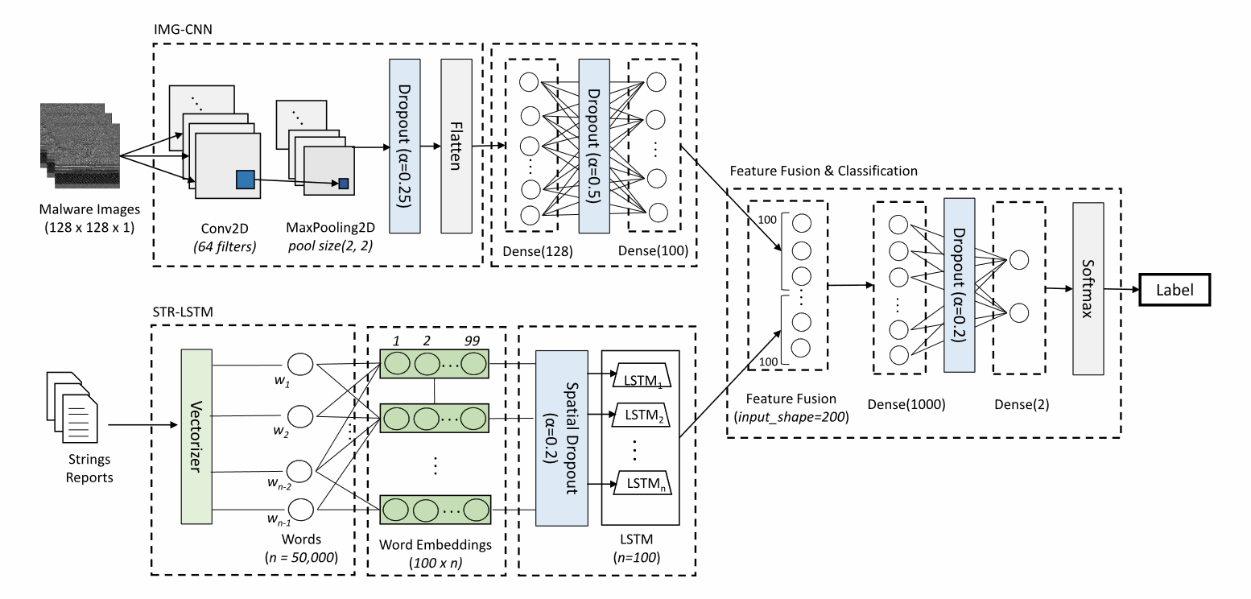

Slide 8
[28] “Recurrent Networks” (Pascanu et al)
RNN and ESN feature extraction into Perceptron for Binary Classification
Some details and contributions
Echo State Machines used for predicting chaotic systems applied to malware
Adversary-generated pseudo-chaos (obfuscation/encryption)
Challenges/problems:
Not to do with the model: Company Secrets
Cross-Validation; Acc. Not Mentioned; TPR: 71.71%, FPR: 0.01% (Low Acc)
Source:
Code: N/A
Data: Microsoft Private Internal Dataset

Slide 9
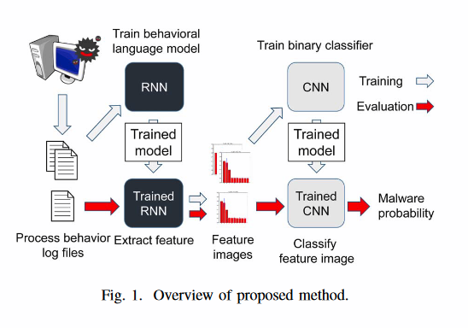
[261] “Process Behavior” (Tobiyama et al)
Dynamic -> RNN -> CNN pipeline
Some details and contributions
Process Log-file analysis
Challenges/problems:
Model requires log files generated by the programs actually being run
Slow; small sample size
CNN 5-fold cross-validation; Avg ROC.: 89.33%
Uses 150 feature images generated by RNN
Source:
Code: N/A
Data: NTT Corporation in Japan (not publicly available)

Slide 10
[37] “Support Vector Machine for Classification” (Agarap)
Tests SVM architectures with different front-end layers
CNN-SVM, GRU-SVM, MLP-SVM
Malware binary as grayscale images -> SVM
Challenges/problems:
Lossy data preprocessing - compressed to 32 x 32 pixel grayscale
Cross-Validation; Highest Acc.: 84.92%
Source:
Code: https://github.com/AFAgarap/malware-classification (+has data as nparray file in directory)
Data: http://old.vision.ece.ucsb.edu/~lakshman
Secondary Readings: (cited source for the malware data)
https://dl.acm.org/doi/pdf/10.1145/2016904.2016908

Slide 11
[265] “VisDroid” (Bakour et al)
Grayscale Image -> Features -> Global and Local-trained classifier ensemble
RF, KNN, DT, Bag of Visual Words, Gradient Boost, ADA Boost
High-Complexity Voting-based model for malware family classification
Challenges/problems:
Big-O > n^2 -- high computational complexity in training
10-fold cross validation; Acc.: 98.2%
Source:
Code: N/A
Data: https://drebin.mlsec.org/ and http://www.malgenomeproject.org/ (shut down)

Slide 12
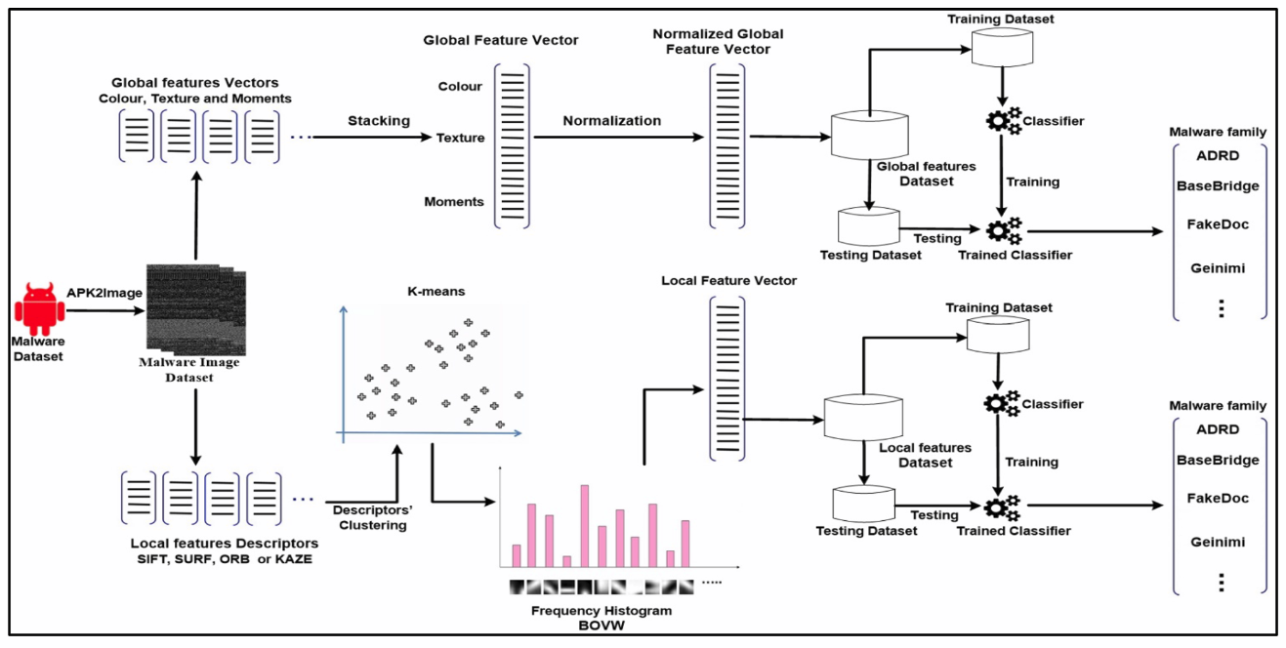

Slide 13
[266] “Vision-Based Detection of Android Malware” (Almomani et al)
Encodes Android APK file as both RGB and Grayscale images
Uses transfer learning for feature extraction
2-fold simul-image-encoding -> transfer learning -> CNN classification
Challenges/problems:
High preprocessing load
Must broadcast training and test data to many input sizes of transfer models
Model training complexity (mitigated somewhat by transfer learning)
80:20 Cross-Validation; Acc.: 99.40%
Source:
Code: N/A
Data: “Leopard Dataset” (cannot find on the web)

Slide 14
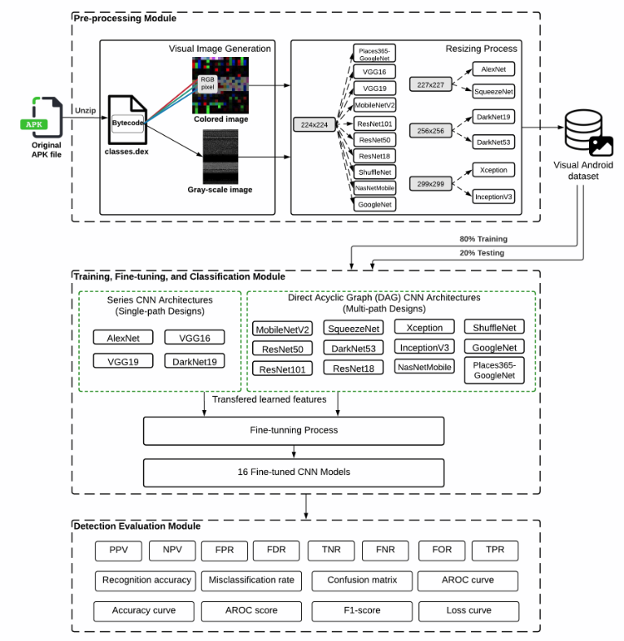
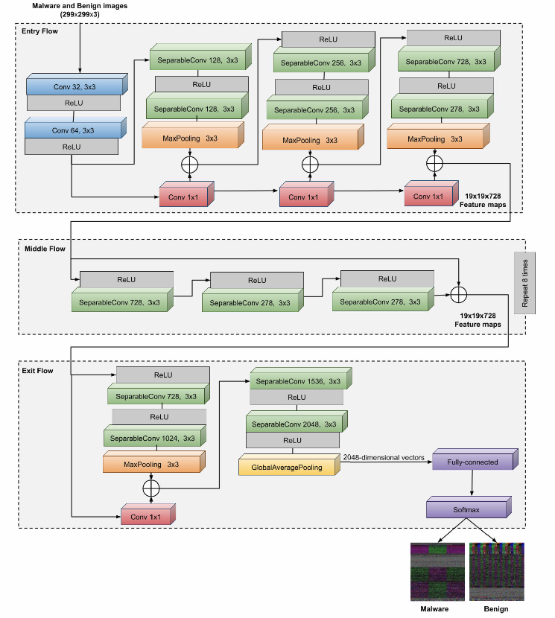

Slide 15
[272] “Performance-Sensitive Detection” (Feng et al)
APK feature extraction using behavior and industrial reporting data
Tests multiple ML models for best performance
GRU-LSTM, Stacked GRU-LSTM, Bi-GRU-LSTM, CNN
Android Defender-style security application
Challenges/problems:
Proposed system relies on external feature extraction via 3rd-party malware report
Cross-validation; Acc.: 96.75%
Source:
Code: N/A
Data: Drebin dataset, Genome project (shut down), VirusShare, VirusTotal, KuafuDet, Contagio Mobile

Slide 16
[273] “Dynamic Robust DL” (Haq et al)
Three Experimental back-end Models for CNN
CNN + LSTM, CNN + BiLSTM, CNN + GRU
Standard Feature Extraction -> CNN for classification
Challenges/problems:
Skewed data selection: <25% malware, >75% benign
Cross-Validation; Avg Acc.: ~99%
Source:
Code: N/A
Data: AndroZoo, https://amd.arguslab.org/ (unavailable)

Slide 17
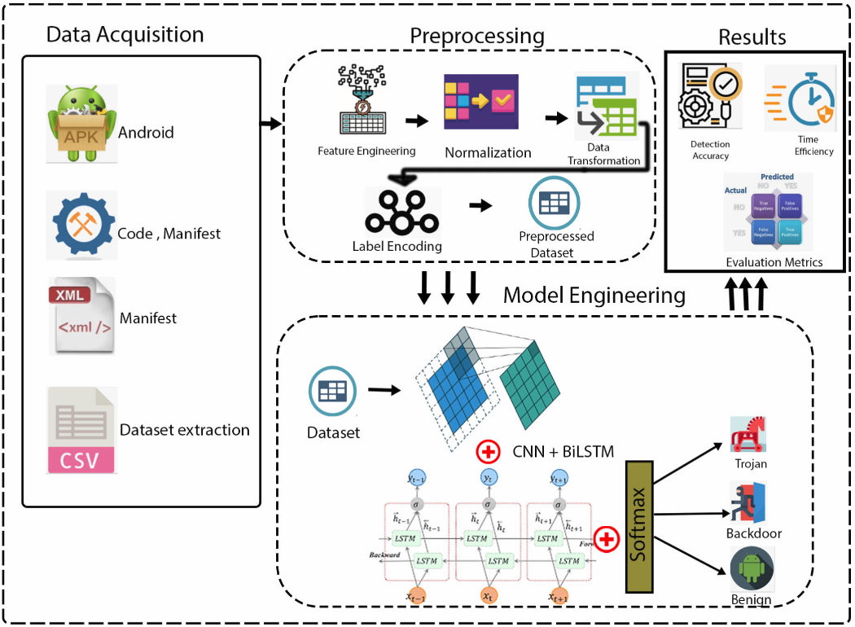

Slide 18
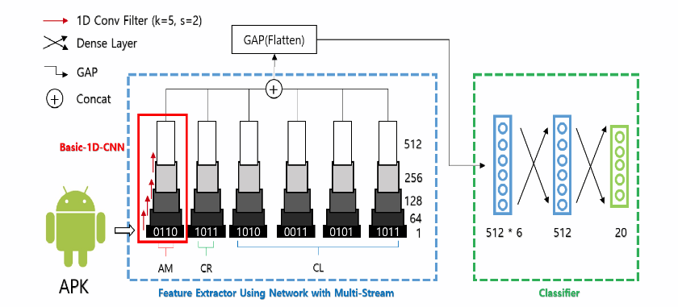
[274] “Multi-Streams Family Classification” (Kim et al)
Basic 1D CNN on binary + concatenation -> DNN
Division of binary file based on android APK format
AM - Android Manifest
CR - Certificate
CL - Classes
6-fold parallel convolution of binary file
Challenges/problems:
Non-generalizable (little transfer learning)
Downsampled Cross-Val; Acc.: 93.2%
Source:
Code: N/A
Data: Drebin dataset, AMD dataset (unavailable)

Slide 19
[275] “Deep-Layer Clustering” (Namrud et al)
Kohonen SOM + K-means
Android apps have explicitly written permission files to request access to certain Android OS api calls
Use clustering to map benign/malware
Clustering on Android Permissions files
Challenges/problems:
Cannot detect low-permission malwares (e.g. social engineering malware)
80:20 Cross-Validation; Acc.: 90.54%
Source:
Code: N/A (some pseudocode in paper)
Data: AndroZoo and apps acquired from the Google Play Store

Slide 20
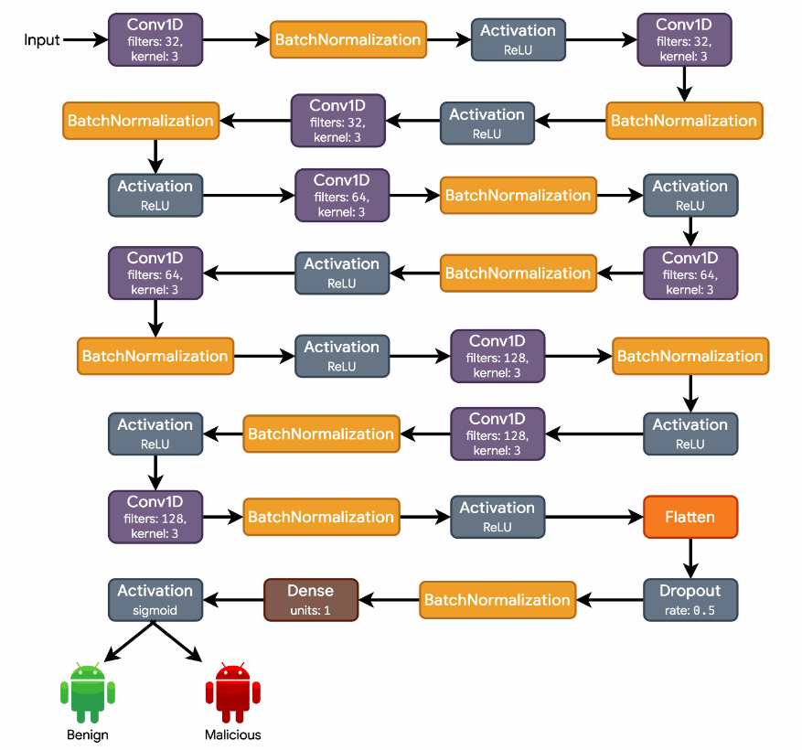
[276] “DroidMalwareDetector” (Kabakus)
Android APK feature extraction -> CNN
Permission files and high-security API calls
Deep CNN on 3x100 feature vectors
Challenges/problems:
High training time; complex runtime
5-fold Cross-Validation; Acc.: 90%
Source:
Code: N/A
Data: AndroZoo, Drebin dataset, KuafuDet, VirusShare

Slide 21
[32] “DeepSign” (David et al)
Hybrid Dynamic/Static Approach
Cuckoo Sandbox Logs as input to 8-layer DBN
Category and Family classification (30 output neurons)
Gradual Layer-Building DBN
Challenges/problems:
Sample dataset of size 1800; relatively small
2:1 Cross-Validation; Acc.: 98.6%
Source:
Code: N/A
Data: Private dataset provided by “C4 Security.”

Slide 22
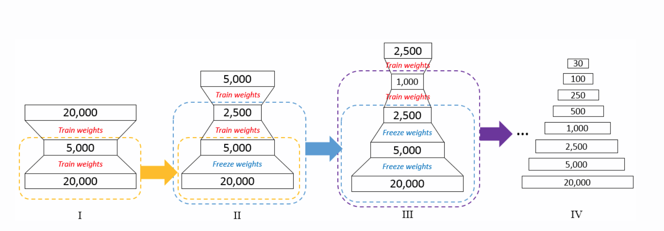

Slide 23
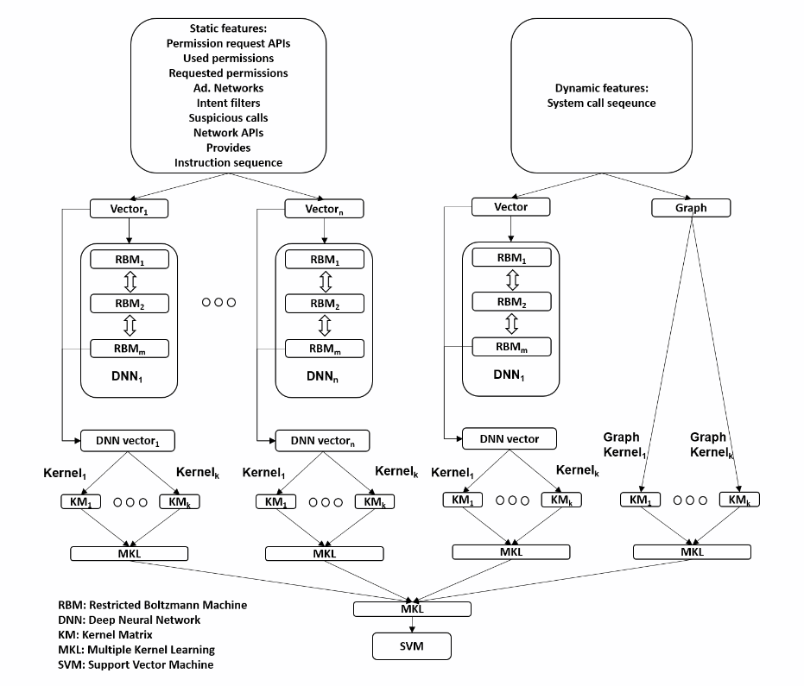
[279] “HADM” (Xu et al)
Features Extracted and divided up among separate DNNs used to generate kernels for SVM
Mitigation of noise by isolating separate streams
Hierarchical MKL SVM
Challenges/problems:
And limitations
10-fold Cross-Validation; Acc.: 94.7%
Source:
Code: N/A (some pseudocode in paper)
Data: VirusShare and Google Play Store

Slide 24
[281] “CNN based on Visualization” (Shiva Darshan et al)
Dynamic Feature Selection Trains the Image Generator then class’d by CNN
Unknown PE file features processed by N-Gram into images for the CNN to process
Features as N-Grams mapped to B/W Images for CNN processing
Challenges/problems:
Decreased detail from binary (On/Off) BW images
10-fold Cross-Validation; Acc.: 97.968%
Source:
Code: N/A
Data: Malheur Dataset

Slide 25
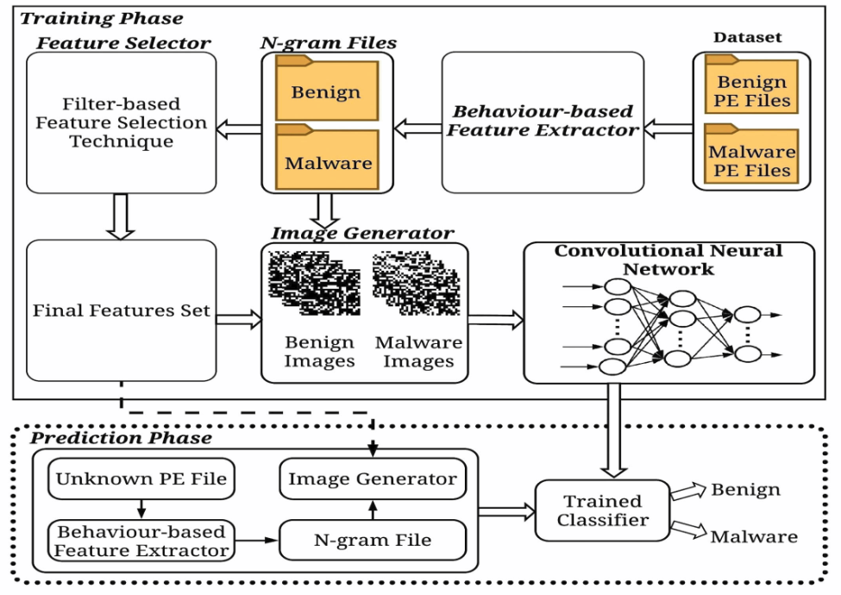
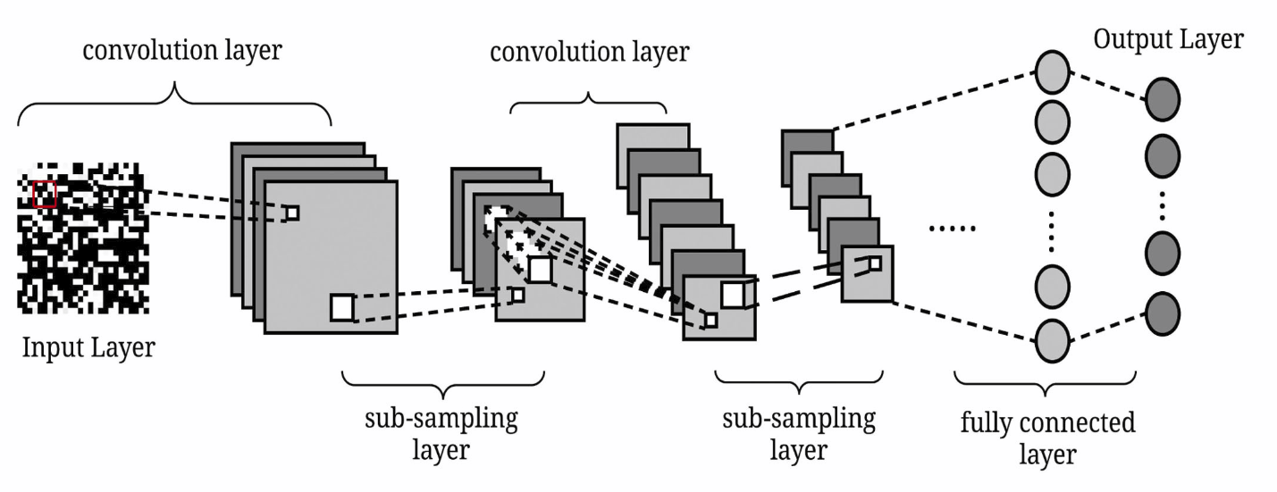

Slide 26
[283] “Optimizing features” (Aslam et al)
3-Layer Dense Encoding -> Ensemble Neural Net -> K-Means/GMM/FCM clustering for classification
Exact models in the Ensemble are not specified by the authors
Bagging-Based Ensemble Network
Challenges/problems:
“Low bias and high variance” Aka Overfitting
Cross-Validation; Avg. Acc.: 95%
Source:
Code: N/A
Data: https://github.com/PacktPublishing/Mastering-Machine-Learning-for-Penetration-Testing

Slide 27
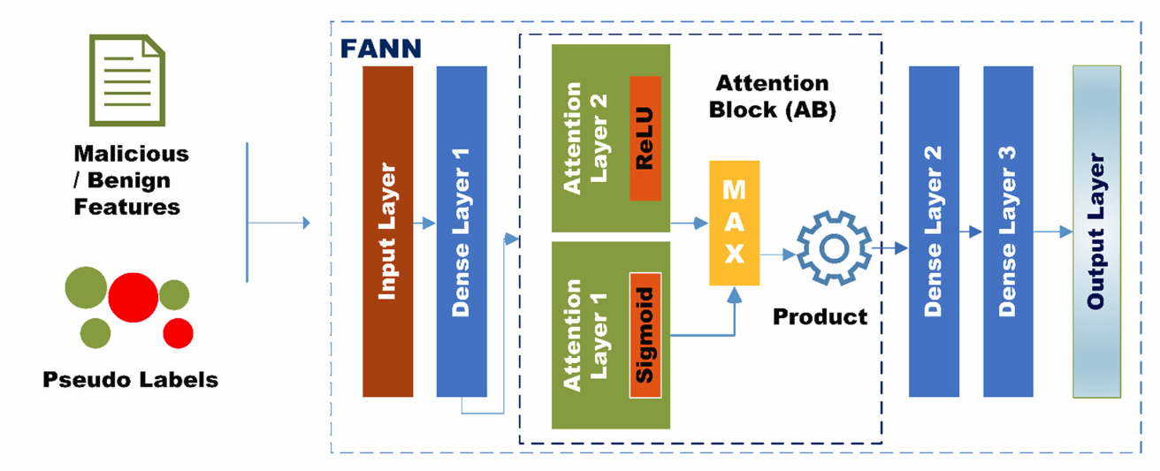
[285] “ProudMal” (Rizvi et al)
K-mean clustering for unsupervised “pseudo-labeling” as input to 4-layer DNN
Feature Attention-based Neural Network
Challenges/problems:
Risk of overfitting
80:20 Cross-Validation; Acc.: 98.09%
Source:
Code: Authors claim the implementation is in the GitHub directory below but it does not appear to be there
Data: https://github.com/syed-nust/PROUD-MAL

Slide 28
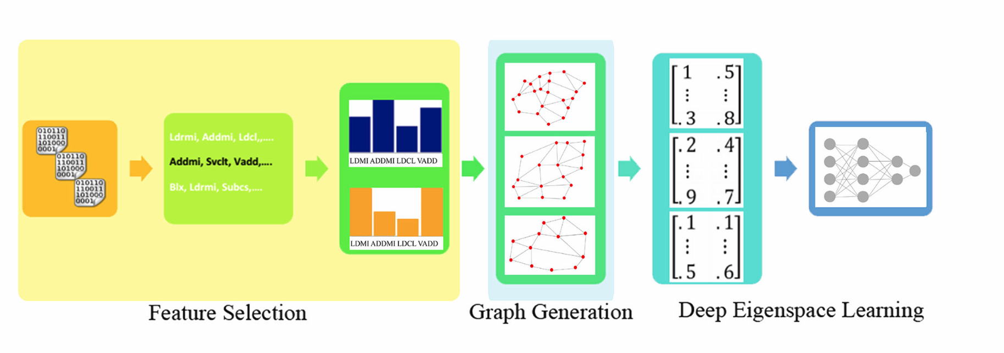
[65] “Battlefield IoT Devices” (Azmoodeh et al)
1 and 2-Gram feature selection -> Control Flow Graph -> Eigenspace of Adj. Matrix -> CNN
Embed Features as Graphs for Eigenspace Learning
Challenges/problems:
Authors Note: Homogenous data (narrow range)
10-fold Cross-Validation; Acc.: 99.68%
Source:
Code: N/A
Data: Goodware: Pi Store (IoT App store) Malware: VirusTotal

